Slide 1

The Exiting Entrepreneur
The art of selling a business and thriving thereafter.

Slide 2

A process as complex as it is rewarding
Selling your business while still managing its daily demands leaves little time to consider your future finances, including wealth management, estate planning and charitable giving.
We’ve assembled a helpful guide combining:
Our detailed knowledge of the key steps
Our years of experience advising corporate executives and business owners

Slide 3
Presale planning
Once you decide to pursue a sale, take the time to consider these crucial questions:
Would I benefit more from a cash sale or an all-stock sale?
How can I work to ensure the business’ full value is realized?
Will post-deal covenants affect my lifestyle?

Slide 4
Presale planning
The key to maximizing the potential value of any transaction is the thorough and strategic evaluation of your available options. As you explore the landscape and before finalizing an agreement, make sure to carefully consider the following factors:
Cash vs. stock payment
Concentrated stock strategies
Weighing valuation
Exploring your financial plan

Slide 5
Cash vs. Stock payment
Deciding between a cash or stock payment can be challenging. There are important things to keep in mind when weighing your options.
Key factors and uncertainties:
Complexity and variation of merger agreements
Forecasting can be difficult
Contractual provisions
SEC regulations

Slide 6
Concentrated stock strategies
Should you elect to receive stock as full or partial payment for the sale of your business, consider the risk associated with holding a concentrated stock position.
Potentially reduce exposure and mitigate risk.
Selling and diversifying
Hedging
Structuring/modifying terms
Floor and ceiling price

Slide 7
Weighing valuation
Frequently the single most important factor in a sale transaction, valuation is something that should be central to your planning both before and after a sale.
Adjust your strategies based on how your business is valued.
Estate planning techniques and timing
Fair market value of business
Public versus private

Slide 8
Exploring your financial plan
It is important to give ample thought and planning time to the assets you will receive from the sale of your business.
These considerations include:
Spend or invest?
Upcoming costs or long-term goals?
Annual budget
Legacy planning

Slide 9

Wealth strategy
Not all successful entrepreneurs fully appreciate the importance and intricacies of the investment process, causing some to make decisions that hinder rather than help results.
Transitioning from running to relying has its benefits:
Expert counsel from a professional advisor
Effective management of proceeds
Fully reaping the long-term rewards of your hard work

Slide 10
Wealth strategy
Relying on investment professionals and determining a clear wealth strategy can help ensure you fully reap the long-term rewards of your hard work. Here are important steps to consider:
Assemble a trusted professional team
Protect your assets
Consider your legacy

Slide 11
Assembling your professional team
You should look to assemble a team of professionals that can help you plan for every facet of your financial life.
Trust and estate attorneys
Wealth strategies groups
Experts on succession and wealth planning

Slide 12
Protecting your assets
Sellers need to protect their assets from more than just investment risk.
Litigation
Identity theft
Liability for domestic help
Kidnapping and ransom

Slide 13
Considering your legacy
You should discuss your intentions for your legacy with your professional team, who can then help you sort through the basics and begin to structure a plan that best reflects your concerns.
Ongoing estate planning
Tax planning
Family office services
Philanthropy
Family governance
Family constitution

Slide 14

Investment management
When it comes to investment management, keep in mind several key considerations:
Avoid the instinct to rush to reinvest the proceeds.
A conservative early approach can help position you against a near-term market drop.
Adjust tactics as your needs and market opportunities allow.

Slide 15
Investment management
Now that you can begin focusing on the future growth of your assets, it’s important to establish methods to help you with:
Managing your cash
Selecting an investment advisor
Fine-tuning your philosophy
Custody and administration
Liquidity solutions

Slide 16
Managing your cash
Once your transaction is complete, your first priority should be finding a secure place to custody your cash or stock.
High-quality money market funds or securities
Cash alternatives
Long-term strategy

Slide 17
Selecting an investment advisor
You should begin the process of selecting an investment advisor by educating yourself on your options.
Step 1: Selecting firms and evaluation criteria
Step 2: Evaluating existing investment relationships
Determining how many firms to employ
The interview process

Slide 18
Finetuning your philosophy
Building the business that created this liquidity took years, and becoming comfortable investing the resulting wealth will require time and patience.
The process is an evolution
Incorporate financial goals while considering market constraints
Evaluate traditional and nontraditional investments
Develop an investment policy statement

Slide 19
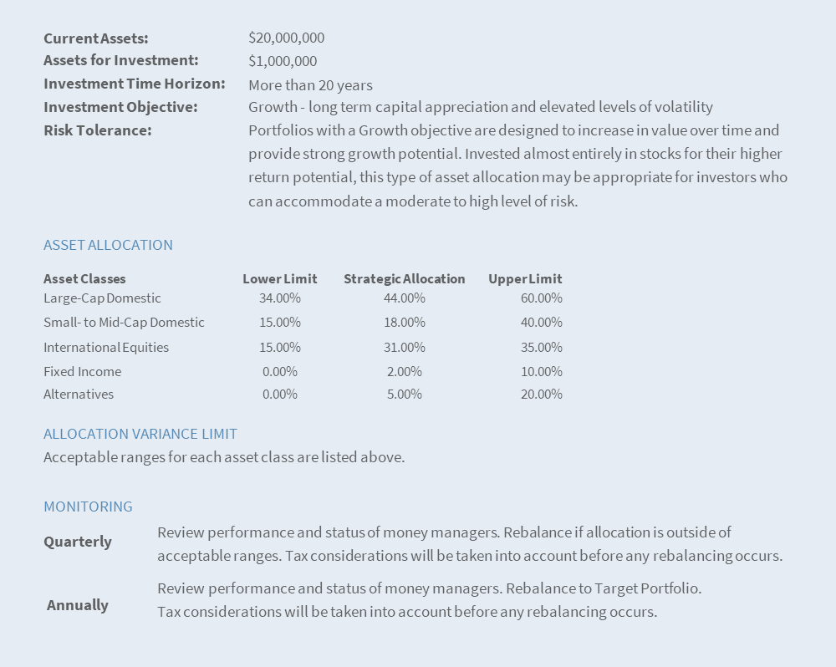
Sample investment policy executive summary
This is a hypothetical example for illustration purposes only. Actual investor results will vary.
Some investment firms will sell the idea of comparing your investment returns to the popular “benchmarks,” such as the S&P 500 or the Dow Jones Industrial Average. However, given that benchmarks are simply data points and can fluctuate substantially, an IPS can serve as a personalized benchmark, requiring accountability from you and your advisors.
The S&P 500 is an unmanaged index of 500 widely held stocks. The Dow Jones Industrial Average is an unmanaged index of 30 widely held stocks. Investors cannot invest directly in this index.

Slide 20
Custody and administration
Choosing the appropriate home for your assets involves more than just selecting savvy advisors.
Robust custody platform
Asset segregation
Additional securities protection coverage

Slide 21
Liquidity solutions
An important aspect of a sound financial advisory relationship includes access to your money with the support of an experienced administrative team.
Prompt and seamless access to your funds
Day-to-day needs solved
Provide back office for your family’s financial affairs
Customized credit solutions

Slide 22

A long-term successful wealth planning strategy
The more knowledge you have when selling your business, the greater the opportunity for you to reap the financial rewards that will help achieve your long-term goals.
At Raymond James, our highly skilled team will provide you with unparalleled guidance and coordination to help create the financial security you worked toward when you first started your business.
We welcome the opportunity to work with you.

Slide 25
INTERNATIONAL HEADQUARTERS: THE RAYMOND JAMES FINANCIAL CENTER
880 CARILLON PARKWAY // ST. PETERSBURG, FL 33716 // 800.248.8863
RAYMONDJAMES.COM
© 2022 Raymond James & Associates, Inc., member New York Stock Exchange/SIPC. © 2022 Raymond James Financial Services, Inc., member FINRA/SIPC. Investment products are: not deposits, not FDIC/NCUA insured, not insured by any government agency, not bank guaranteed, subject to risk and may lose value. Raymond James® is a registered trademark of Raymond James Financial, Inc. This information was developed by Raymond James. It is general in nature, and is intended solely for the purpose of illustrating conceptually how a particular sale of a business might work, based on various assumptions. Whether the planning technique is appropriate for you will depend on your goals and your specific situation. Small and mid-cap securities generally involve greater risks and are not suitable for all investors. International investing involves additional risks such as currency fluctuations, differing financial accounting standards, and possible political and economic instability. These risks are greater in emerging markets. The market value of fixed income securities may be affected by several risks including interest rate risk, default or credit risk, and liquidity risk. The process of rebalancing may result in tax consequences. Alternative investment strategies involve greater risks and are only appropriate for the most sophisticated, knowledgeable and wealthiest of investors. This is not a complete statement of all information necessary for making an investment decision, and is not a recommendation or a solicitation to buy or sell any security. Investments and strategies mentioned may not be suitable for all investors. Past performance may not be indicative of future results. Asset allocation and diversification do not guarantee a profit nor protect against a loss. Raymond James does not provide advice on tax, legal or mortgage issues. These matters should be discussed with an appropriate professional.

Slide 26
INTERNATIONAL HEADQUARTERS: THE RAYMOND JAMES FINANCIAL CENTER
880 CARILLON PARKWAY // ST. PETERSBURG, FL 33716 // 800.248.8863
RAYMONDJAMES.COM
© 2022 Raymond James & Associates, Inc., member New York Stock Exchange/SIPC. © 2022 Raymond James Financial Services, Inc., member FINRA/SIPC. Investment products are: not deposits, not FDIC/NCUA insured, not insured by any government agency, not bank guaranteed, subject to risk and may lose value. Raymond James® is a registered trademark of Raymond James Financial, Inc. This information was developed by Raymond James. It is general in nature, and is intended solely for the purpose of illustrating conceptually how a particular sale of a business might work, based on various assumptions. Whether the planning technique is appropriate for you will depend on your goals and your specific situation. Small and mid-cap securities generally involve greater risks and are not suitable for all investors. International investing involves additional risks such as currency fluctuations, differing financial accounting standards, and possible political and economic instability. These risks are greater in emerging markets. The market value of fixed income securities may be affected by several risks including interest rate risk, default or credit risk, and liquidity risk. The process of rebalancing may result in tax consequences. Alternative investment strategies involve greater risks and are only appropriate for the most sophisticated, knowledgeable and wealthiest of investors. This is not a complete statement of all information necessary for making an investment decision, and is not a recommendation or a solicitation to buy or sell any security. Investments and strategies mentioned may not be suitable for all investors. Past performance may not be indicative of future results. Asset allocation and diversification do not guarantee a profit nor protect against a loss. Raymond James does not provide advice on tax, legal or mortgage issues. These matters should be discussed with an appropriate professional.

